Slide 1
Apollo Business Consulting Network Design Proposal
shana.
NETWORKS

Slide 2
Apollo: Innovation, Collaboration, & Excellence
311 active employees
Innovative solutions to everyday business problems
Operates several in-house servers
Various web-based applications and services
Plans to expand into a new future-forward 5 floor facility
Will need a robust, scalable network to support this growth…
shana.
NETWORKS

Slide 3
Agenda
Proposed network solution to support Apollo’s relocation.
Three-layer network design
Core / Distribution / Access level hardware
Cabling summary
Overview of proposed logical / physical designs
Cost Breakdown
An industry leading network that will scale with you!
shana.
NETWORKS

Slide 4
Layout & Logic
Adam Lo Giudice
shana.
NETWORKS

Slide 5
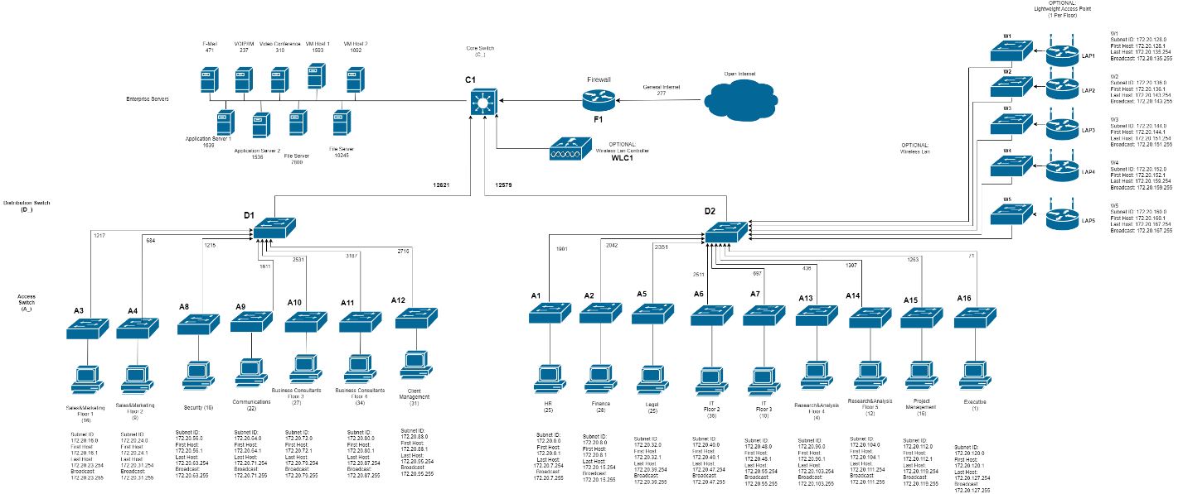
Logical Map OVerview
shana.
NETWORKS

Slide 6
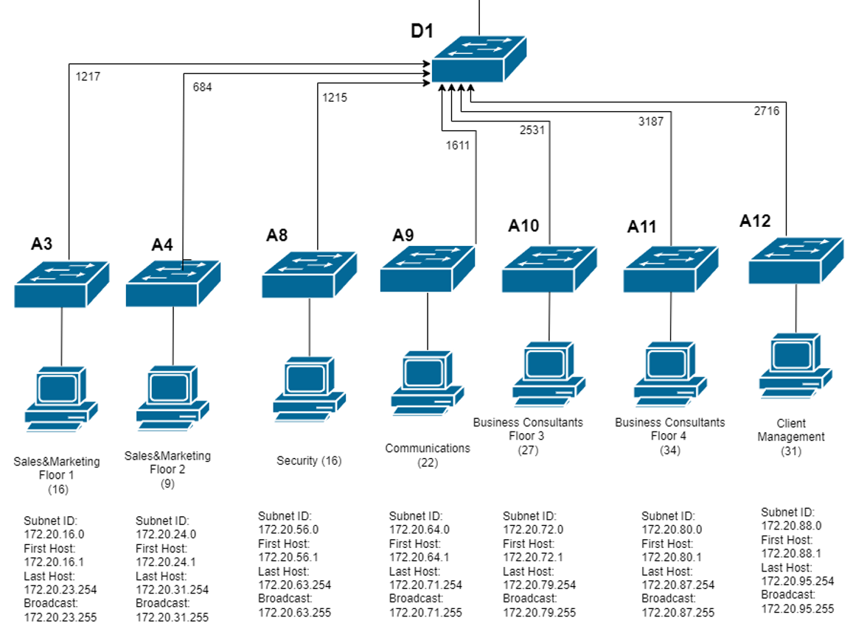
Logical Map D1
shana.
NETWORKS

Slide 7
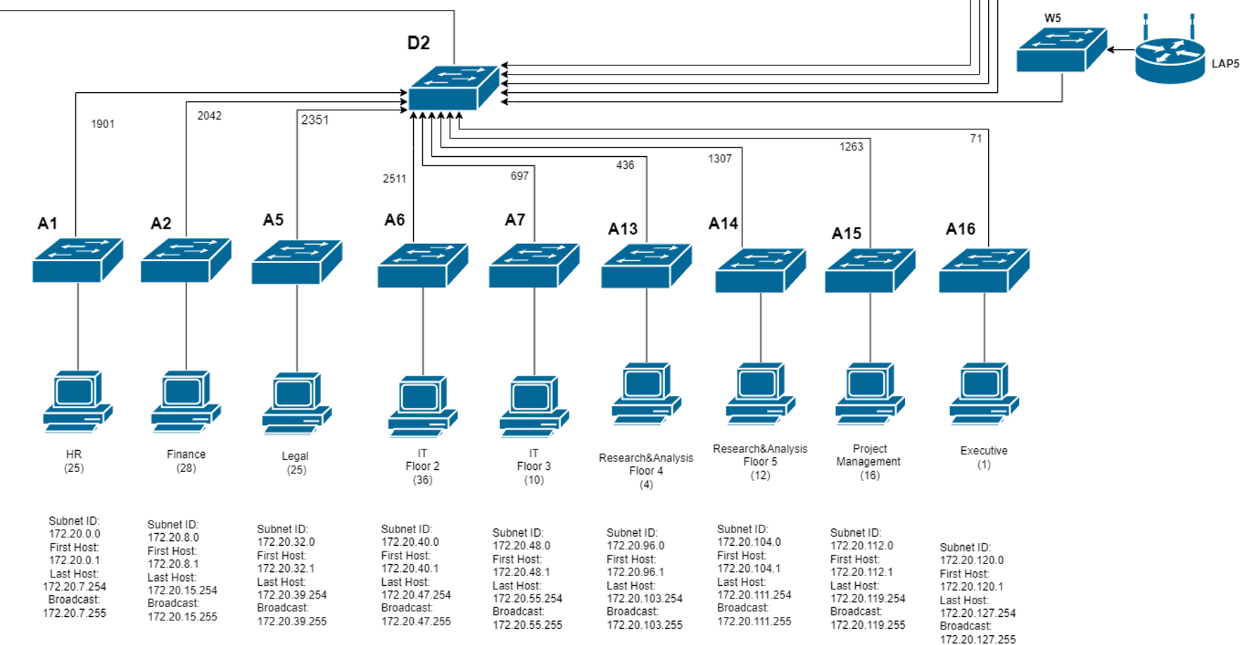
Logical Map D2
shana.
NETWORKS

Slide 8
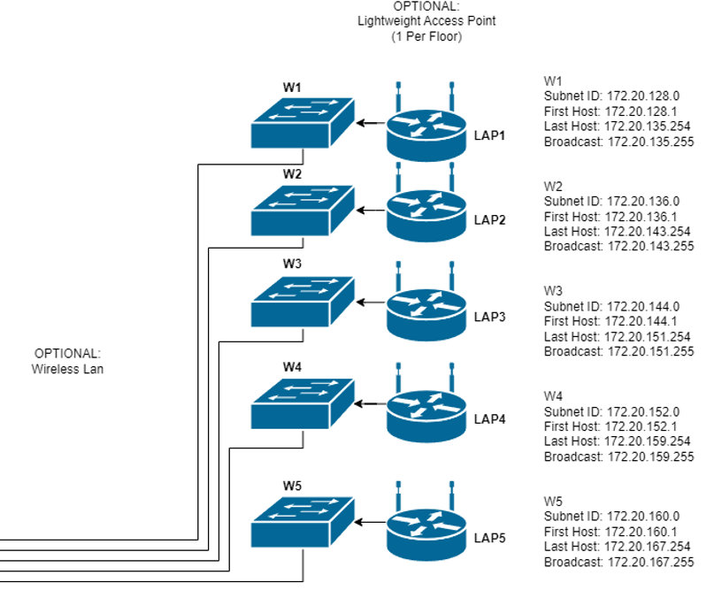
Logical Map W_ (optional)
shana.
NETWORKS

Slide 9
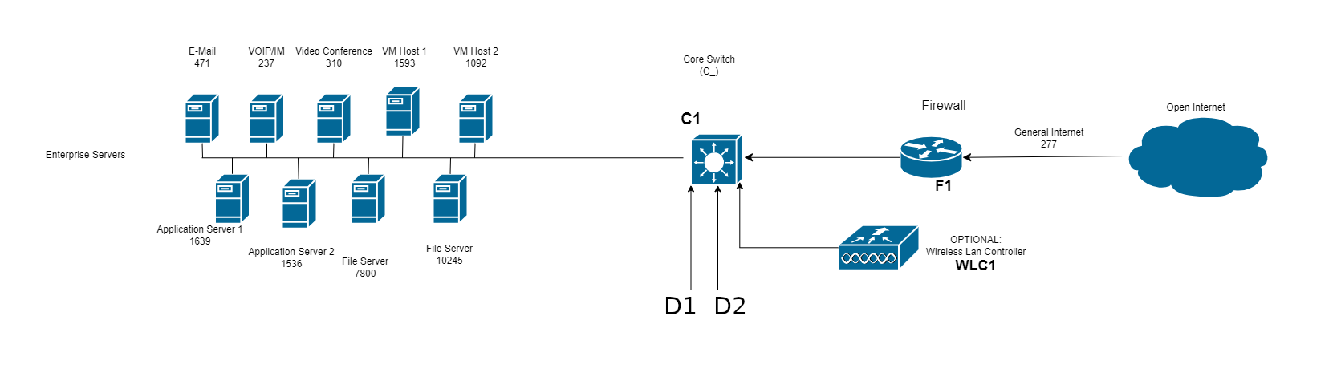
Logical Map Core
shana.
NETWORKS

Slide 10
Hardware
Scott Richards
shana.
NETWORKS

Slide 11
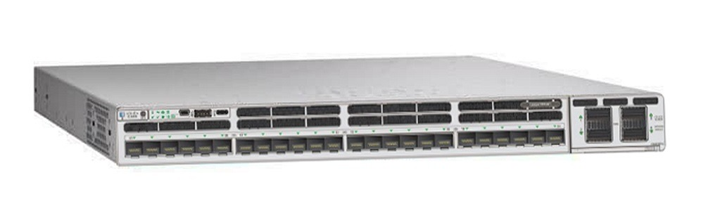
Core / Distribution
Cisco Catalyst 9300X – 24 Port (C9300X2-24Y) (3x)
Built for enterprise grade security and scalability
Flexible modular uplinks of either 100, 40, 24, 10, or 1 Gbit
11 integrated routing protocols
Private VLAN functionality
Built for expansion
Stackable and backwards compatible
Our design implements 3
One for core, two for distribution
Will provide nearly twice the required uplink per distribution trunk (~12.6 Gbit/s)
shana.
NETWORKS

Slide 12
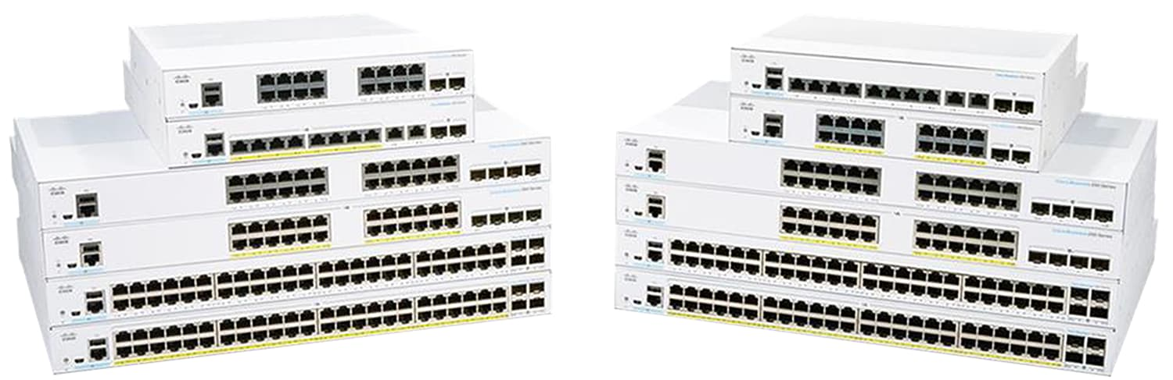
Access LEvel
Cisco Business 350 Series
CBS350-48FP-4X x8
CBS350-24FP-4X x8
CBS350-8FP-E-2G x5
Managed, stackable, feature-packed
POE+ on every port
Policy based routing
VLAN support
4x 10Gbit SFP+ uplinks to serve a max department bandwidth of ~3.3Gbit/s
shana.
NETWORKS

Slide 13
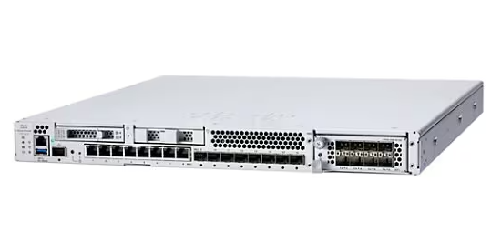
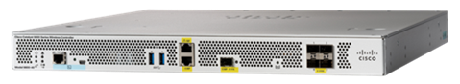
Firewall and Optional WLC
Cisco FirePOWER 3140 Next Gen Firewall (FPR3140-NGFW-K9) (1x)
48 Gbit throughput, industry leading security features.
Cisco Catalyst 9800 Wireless Controller (C9800-40-K9) (1x)
Robust and secure, capable of controlling up to 2000 Aps
See report for details on wireless option
Firewall WLC
shana.
NETWORKS

Slide 14
Cabling
Neil Power
shana.
NETWORKS

Slide 15
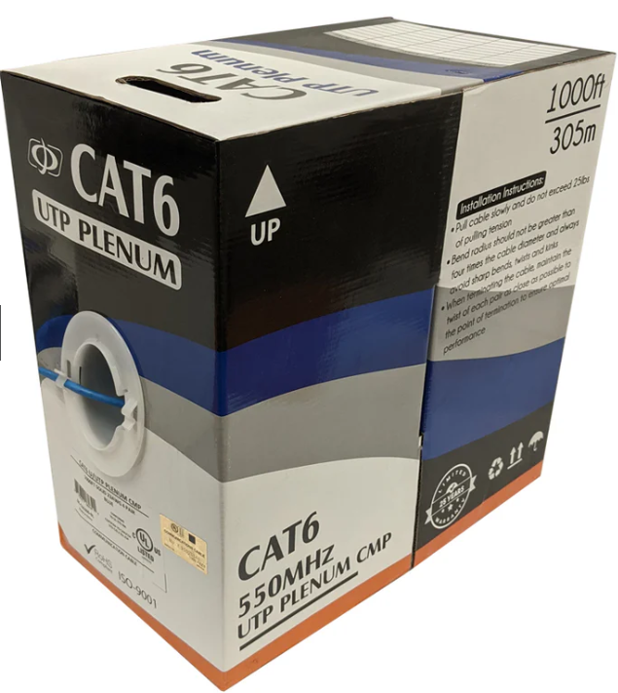
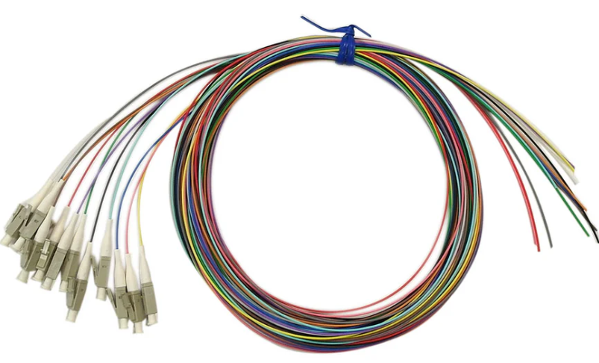
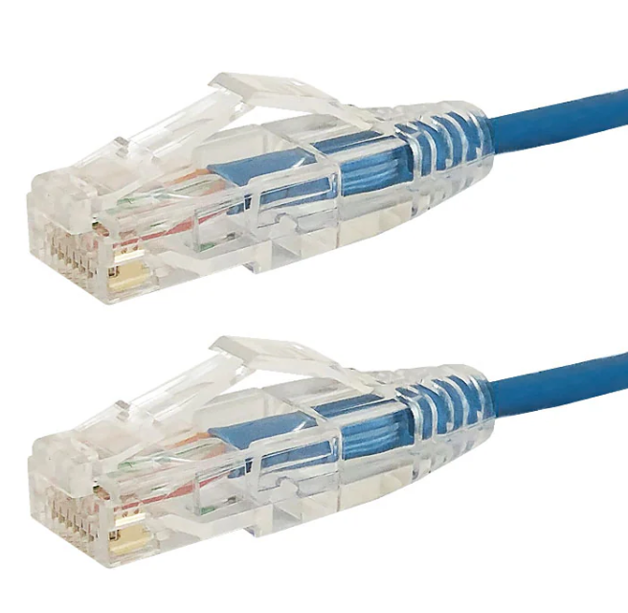
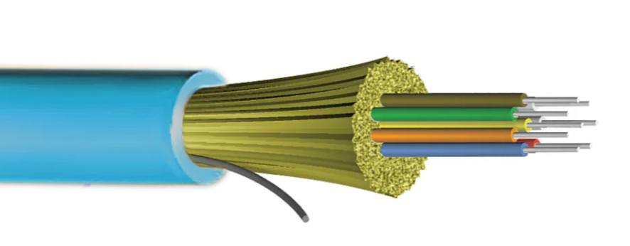
Cabling
Placement | Type | Total Length | Cost Estimate
Work Area | Category 6 | 1691 meters | ~$4,633.34
Horizontal | Category 6 | 11792 meters | ~$124,363.35
Backbone | Multi-mode Fiber | 345 meters | ~$3,057.60
TR Patch Cables | Cat6/Fiber | 163 meters | ~$1,040.45
shana.
NETWORKS

Slide 16
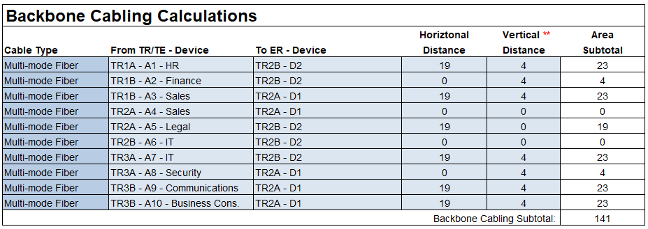
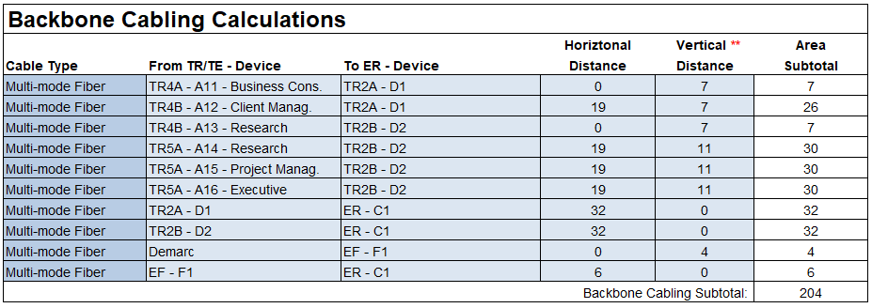
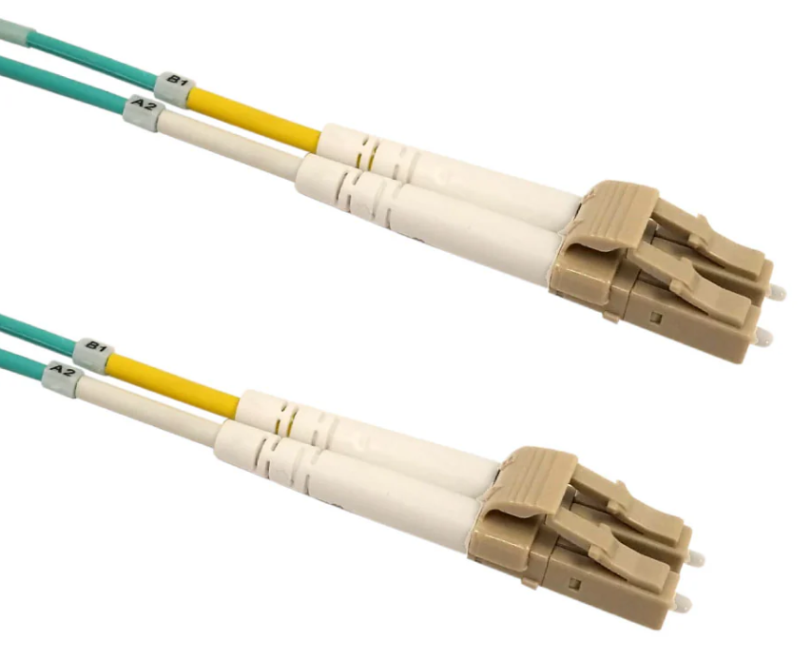
Cabling
shana.
NETWORKS

Slide 17
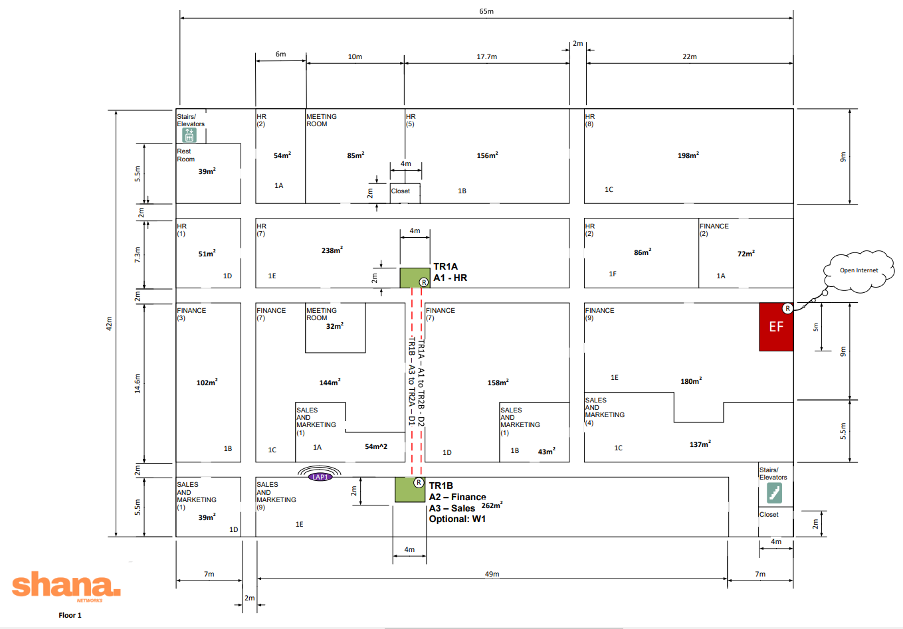
Floor 1
shana.
NETWORKS

Slide 18
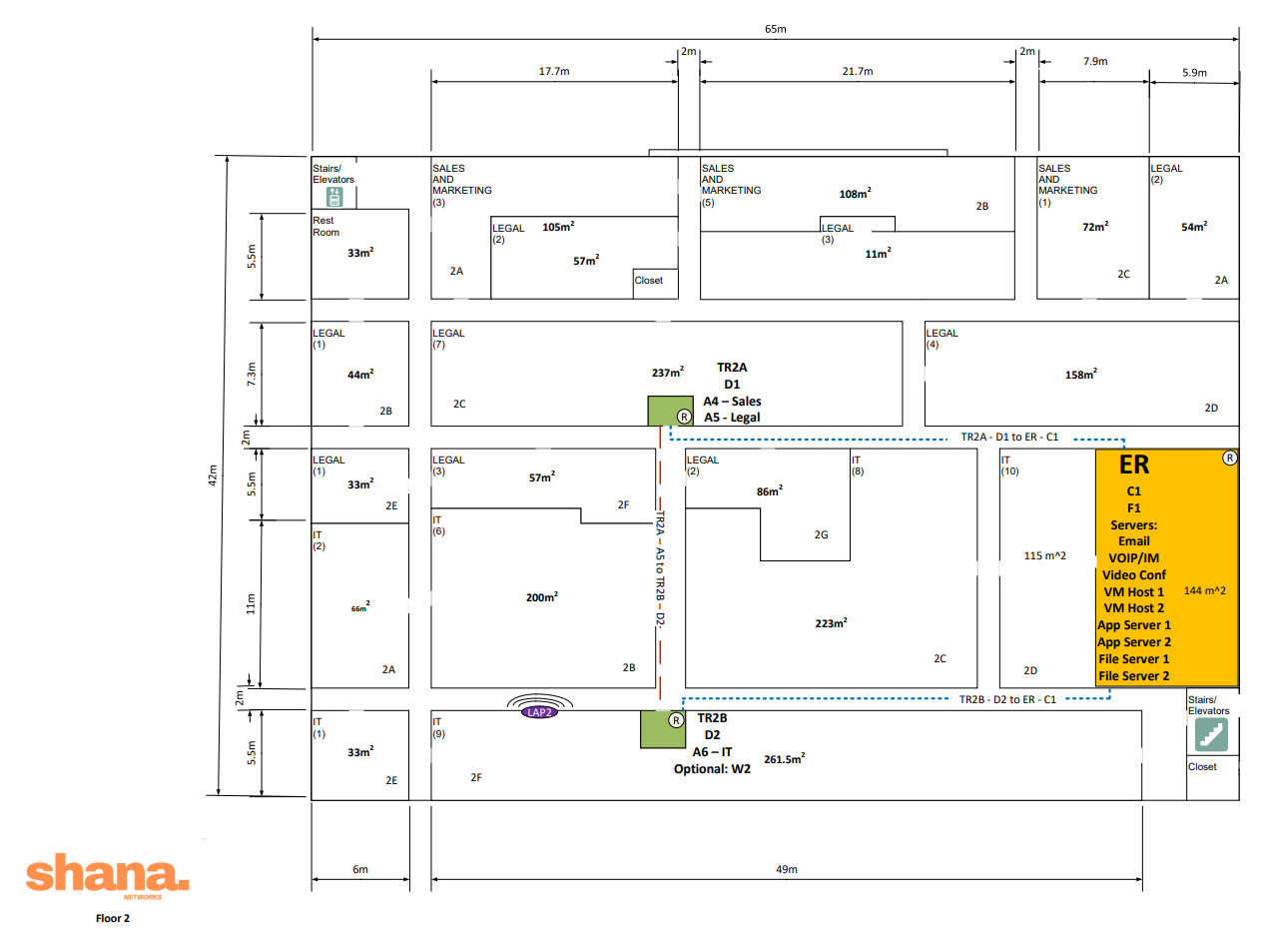
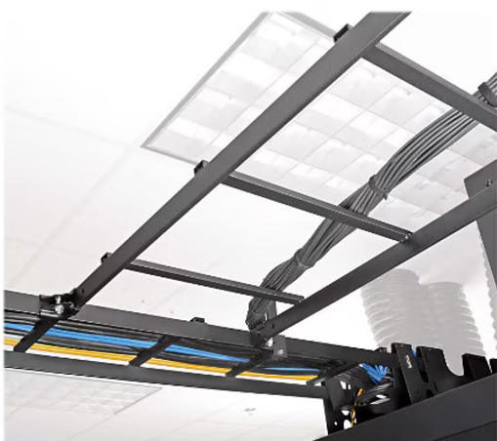
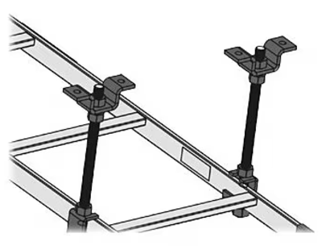
Floor 2
shana.
NETWORKS

Slide 19
Cost-Analysis
Henry Oyewole
shana.
NETWORKS

Slide 20
Cost-Analysis
Provided hardware is of the highest grade
Will allow for scalability and expansion as needed
Estimated yearly upkeep of ~10%
Room for adjustment as per Apollo’s requirements / budget flexibility
May reduce cost but…
We recommend this configuration for adoption
Total acquisition cost: $531,639.35
Yearly upkeep: $ 34,992.57
shana.
NETWORKS

Slide 21
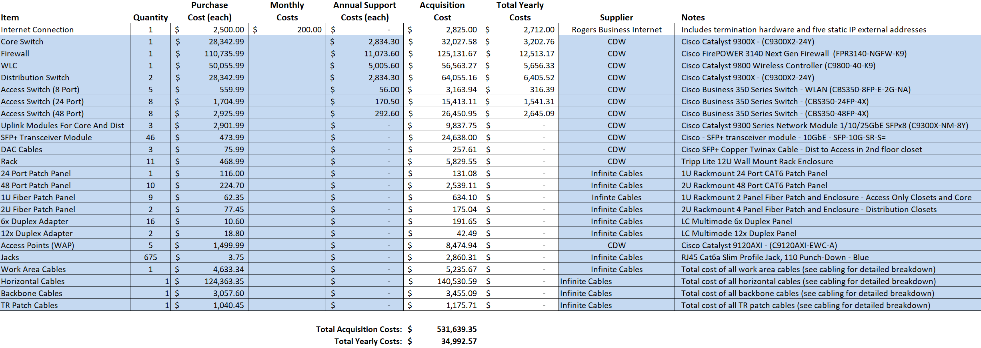
Cost Breakdown
shana.
NETWORKS

Slide 22
Conclusion
Antonio Giacchetti
shana.
NETWORKS

Slide 23
Thank You!
shana.
www.shana.com * business@shana.com *
NETWORKS
Network Infrastructure COMP 10019 Group 12 * not implemented

